Slide 1

Literature Review
Dr Nikolaos Ersotelos

Slide 2
Session objectives
What is a review of literature?
Why are literature reviews necessary?
How can you create a literature review chapter?
Searching for sources
Reading papers
When should you stop reading
Organize the information
Writing your literature review
Time needed
How to read and select important journals
Note taking process
Dr Nikolaos Ersotelos

Slide 3
What is a review of literature?
A literature review is a description of the literature relevant to a particular field or topic.
It can be a critically analysis of published research papers/books with a comparison to a new research contributions
This is often written as part of:
A postgraduate thesis proposal
A commencement of a thesis
A separate assignment
Dr Nikolaos Ersotelos

Slide 4
Why are literature reviews necessary?
A literature review shows how the investigation you are conducting fits with what has gone before and puts it into context
You have to convince the reader that you have understood and critically analyzed the background research
Provides evidence that may help explain your findings later
Show how your investigation relates to previous research
Based on the literature review you can find methodologies/approaches, which will help you to solve problems which will be revealed during your research
Dr Nikolaos Ersotelos

Slide 5
How can you create a literature review chapter?
(Search for relevant publications)
Firstly you must define the topic of your research
You must search for the latest relevant to your topic published papers
TIP!!! If you want to find older approaches, you can use the "references chapter" of those papers
You may find perhaps not directly relevant to your topic papers but relevant to your overall investigation
Dr Nikolaos Ersotelos

Slide 6
How can you create a literature review chapter?
Searching for sources
Web searching machines.(e.g. GOOGLE, GOOGLE scholar, researchGate, IEEE, etc)
University library
Academic books, Journals, research reports, conference papers.
The university of Wolverhampton can provide full access to most important publications
TIP!!! Survey papers (include several major papers which are relevant to your topic also they include author’s comments for every mentioned approaches)
Dr Nikolaos Ersotelos

Slide 7
How can you create a literature review chapter?
How to read and select important journals
When you are trying to find relevant papers:
Skim reading:
Read the summary or the abstract or the introduction of the paper.
Look at conclusions, discussion, or headings.
Read the whole article when:
The paper is important and relevant to your chapter.
When the paper is a seminal piece of work.
You may get ideas from it.
Academic books are often more useful in that they provide content and especially indexes to look up keywords.
Dr Nikolaos Ersotelos

Slide 8
How can you create a literature review chapter?
Reading papers
You have already selected the most relevant to your research topic papers
Keep notes for every paper while you are reading it
When you have finished reading a paper write a small summary
TIP!!! That summary you will use it on you literature review chapter
Dr Nikolaos Ersotelos

Slide 9
How can you create a literature review chapter?
When should you stop reading
It depends of how long your literature review chapter must be
Do not read hundreds of papers if your literature review chapter must be up to 1000 words
For instance: if your want to publish a 4 pages conference paper you cannot add 3 pages references (list of selected papers)
IMPORTANT!! You must not avoid major papers relevant to your topic. (many students are concentrate on a specific part of their research topic by providing a big literature review chapter avoiding the rest of their topic aspects)
Manage the materials which will be included on the literature review chapter
Dr Nikolaos Ersotelos

Slide 10
How can you create a literature review chapter?
Organize the information
If you have too much information try to group what you have read into different topics or themes
“For example, high quality facial expression with ﬁne details was created from a set of existing photos using different techniques, as in [5, 14, 23, 46, 47].”
Nikolaos Ersotelos, Feng Dong: Building highly realistic facial modeling and animation a survey, 2008
Do not refer everything in the same depth in your literature review
Dr Nikolaos Ersotelos

Slide 11
How can you create a literature review chapter?
Writing your literature review
Introduction:
Define or identifying the general topic, issue, or area of concern
Explain to the reader the scope or purpose of the literature review chapter and how is relevant to your research
Provide some key points of the materials which will be analyzed in the chapter
Body:
The most relevant to your topic papers must analytically (the modified summary which already was mentioned) be included
In the main body you will convince the reader for your research background. Answer the Six W’s of literature review (Who, When, Where, how, What, Why)
Dr Nikolaos Ersotelos

Slide 12
How can you create a literature review chapter?
Writing your literature review
Conclusion:
In the conclusion you can include any gaps or problems with the existing research and how your investigation is going to address these gaps or build on the existing research
IMPORTANT!! Be certain that on the “discussion section” of your paper you will provide evidence to help explain the findings of your investigation and how you solved the mentioned gaps.
Discussion chapter: is the section on your paper/dissertation where you refer to your contribution based on what you have referred on your literature review section
Dr Nikolaos Ersotelos

Slide 13
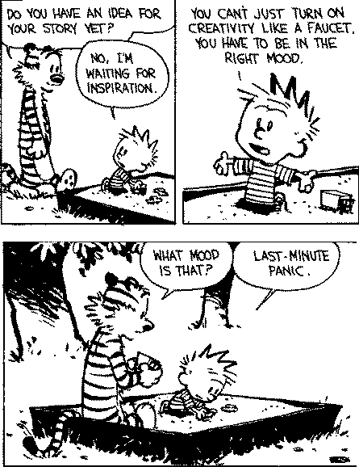
Time needed
Writing your literature review takes time
Manage much time to find the most important and up to date papers relevant to your topic
Manage much time to read all the paper and create academic summaries
Group the papers according to the subject/approach/contributions they have implemented not based on the chronological description
Dr Nikolaos Ersotelos
http://www.scribd.com/doc/164611304/GWC-Lit-Review-presentation-Matt-W-ppt

Slide 14
Time needed
If you find a gap or problem on existing research be firstly sure about it and then academically indicate it.
You may need to complete several drafts before your final copy.
Dr Nikolaos Ersotelos
http://www.scribd.com/doc/164611304/GWC-Lit-Review-presentation-Matt-W-ppt

Slide 15
Note taking process
When you take notes you avoid unintentional plagiarism
You are focus on what is important
Helps you understand better the paper
You may define prior to paper reading questions based on your research interests (this will help you to find if the paper which you are reading is relevant to your research subject)
Dr Nikolaos Ersotelos

Slide 16
Session Conclusion
Select topic / research subject
Library
Search for latest papers/book chapter
Internet
Keep notes for every paper you read
Find gaps
Create summary for every paper you read
Find problems
Categorize your material
Justify why your research is important
Dr Nikolaos Ersotelos

Slide 17
References
http://www.palgrave.com/skills4study/studentlife/postgraduate/carrying.asp
http://www.canberra.edu.au/studyskills/writing/literature
https://www.dlsweb.rmit.edu.au/lsu../content/2_AssessmentTasks/assess_tuts/lit_review_LL/writing.html
http://www.scribd.com/doc/164611304/GWC-Lit-Review-presentation-Matt-W-ppt
http://www.reading.ac.uk/web/FILES/sta/A5_Literature_Reviews_1_Starting.pdf
http://www.writing.utoronto.ca/advice/specific-types-of-writing/literature-review
http://writing.wisc.edu/Handbook/ReviewofLiterature.html
http://www.reading.ac.uk/internal/studyadvice/StudyResources/Essays/sta-startinglitreview.aspx
Questions
Dr Nikolaos Ersotelos

